Slide 1
Canto 1 Chapter 8 Summary

Slide 2
Chapter 8 Summary
Texts 1-16: Krsna Again Saves His devotees
Texts 17-36: Kunti Devi Begins to offer Prayers
Texts 37- 43 : Kunti Devi Concludes by Expressing Her Fear- and Her Actual Desire
Texts 44-52: Krsna accepts Kuntidevi’s Prayers and Hears the distresed Words of Yudhishthira Maharaja

Slide 3
Texts 1-16: Krsna Again Saves His devotees
Importance of being in the association of sadhus:
The Pandavas along with Dhritharastra, Gandhari, Kunti, Subhadra and Draupadi deliver water to the dead relatives. Lord Krishna is with them.
When the Pandavas and their family members are grieving the munis and Lord Krishna pacify them citing the stringent laws of nature
SP purport(1.8.4): “This clearance of the misgivings of material existence at once takes place by association with the Lord's devotees, who are able to inject the transcendental sound into the depths of the bewildered heart and thus make one practically liberated from all lamentation and illusion. That is a summary of the pacifying measures for those affected by the reaction of stringent material laws, exhibited in the forms of birth, death, old age and disease, which are insoluble factors of material existence. ”
Lord Śrī Kṛṣṇa caused three well-performed Aśvamedha-yajñas [horse sacrifices] to be conducted by Mahārāja Yudhiṣṭhira . After this the Lord prepares for his departure.

Slide 4
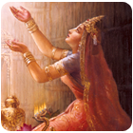
Texts 1-16: Krsna Again Saves His devotees
Text 8: As soon as He seats Himself on the chariot, He sees Uttara running towards Him in fear
Text 9: Uttara cries to the Lord for protection:
uttarovāca
pāhi pāhi mahā-yogin
deva-deva jagat-pate
nānyaḿ tvad abhayaḿ paśye
yatra mṛtyuḥ parasparam
Uttara said: O Lord of lords, Lord of the
universe! You are the greatest of mystics.
Please protect me, for there is no one
else who can save me from the clutches
of death in this world of duality.
Uttara says Let that Brahmastra kill me , if you so desire, but please protect my embryo.
Srila Sridhar Swami states that apart from Krishna there is no one devoid of fear

Slide 5
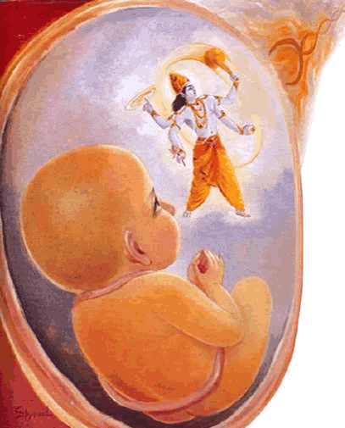
Texts 1-16: Krsna Again Saves His devotees
The Lord understands that Ashvatthama had unleashed two more Brahmastras
The Lord immediately takes up His Sudarshana Chakra
Text 13: ananya-viṣayātmanām is significant. The Pāṇḍavas were cent percent dependent on the protection of the Lord, although they were all great warriors themselves. But the Lord neglects even the greatest warriors and also vanquishes them in no time. When the Lord saw that there was no time for the Pāṇḍavas to counteract the brahmāstra of Aśvatthāmā, He took up His weapon even at the risk of breaking His own vow.
Krsna protected the Pandavas by
counteracting the Brahmastra with his
Disc. He protects the child in Uttara’s
womb by covering it with His internal
energy

Slide 6
Lessons: From Ashvatthama
Dronacarya’s son but still not expert in religious principles and archery(kills the sleeping sons of Draupadi, does not know how to withdraw the Brahmastra, tries to kill a pregnant woman)
We may remain in the movement and have the opportunity to receive all the mercy but if we do not receive it , we will remain like Ashvatthama
Could not take shelter because of offenses
When his horses got tired he released the Brahmastra in Chapter 7. Unlike Arjuna he could not take shelter of the Lord in difficulty because he had offended the Lord and His devotees.
Similarly if we commit offenses to the Lord and His devotees it will be difficult for us to take their shelter.
Does not pacify his burning misplaced anger and after so many years tries to kill all the Pandavas and Pariksit
We can remain consumed in the fire of anger and envy for years. We will continually do the wrong things if we do not Tolerate being corrected. Ashvatthama could not tolerate being corrected when he was humiliated for killing the sons of Draupadi. E.g Cow’s tolerance
He lacked gratitude – that for such a heinous offense he was not killed but only humiliated and was respected by Draupadi and the Pandavas
In the absence of tolerance there is material bewilderment that causes us to entangle ourselves

Slide 7
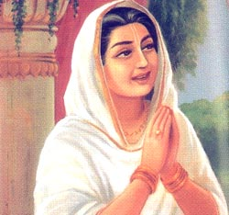
Texts 17-36: Kunti Devi Begins to offer Prayers
SB 1.8.17: Thus saved from the radiation of the
brahmāstra, Kuntī, the chaste devotee of the Lord,
and her five sons and Draupadī addressed
Lord Kṛṣṇa as He started for home.
Definition of a chaste devotee(Purport 1.8.17):
A chaste devotee of the Lord does not look to others, namely any other living being or demigod, even for deliverance from danger…… Such a chaste devotee also never asks the Lord for help, but the Lord, out of His own accord, is always anxious to render it.

Slide 8
Texts 17-36: Kunti Devi Begins to offer Prayers
(1.8.18) You are existing both within and without everything, yet You are invisible to all and unaffected by the material qualities.
Kunti Devi answers her own question :
(1.8.19) The deluding energy covers the eyes of conditioned souls exactly as an actor in disguise is unrecognized
Kunti Devi states however: (1.8.20)
“You Yourself descend to propagate the transcendental science of devotional service unto the hearts of the advanced transcendentalists and mental speculators, who are purified by being able to discriminate between matter and spirit. How, then, can we women know You perfectly?”
She teaches us the proper humility by which we must approach the Lord.
One must feel humility. Material strength, beauty, intelligence and good qualities are insufficient.
Sincerity of purpose is important
Sri Jiva Goswami comments that Krishna comes to the world so that embodied souls may learn to fix their thoughts on His Lotus Feet and devotees taste the happiness of devotional service.

Slide 9
Texts 17-36: Kunti Devi Begins to offer Prayers
Next Prayer states Krishna in relationship to His devotees and therefore offers hope to women(1.8.21):
“Let me therefore offer my respectful obeisances unto the Lord, who has become the son of Vasudeva, the pleasure of Devakī, the boy of Nanda and the other cowherd men of Vṛndāvana,
and the enlivener of the cows and the senses. “
Krishna’s devotees are most dear to Him.. Indeed , His most intimate names are those that indicate His dealings with His devotees.When He hears those names it melts His heart and He remembers those devotees
(1.8.22) Compares the Lord to a Lotus – abdomen, garland, glance and lotus marked feet
(1.8.23-24) Just as the waxy coating on a lotus leaf protects it from the water in which it sits, so You are not truly of this world. Still You have protected the lives of Your devotees, the Pandavas, again and again.
KuntiDevi is afraid that Krishna will leave them with Yudhishthira securely in power. Thus she illuminates a deeper relationship with Krishna that “God, the remover of the devotees’ dangers.”. Instead she points to the higher realization that devotees do not desire an anxiety free life bereft of Krishna’s association, but even a life of trial if such trials keep them in Krishna’s association.

Slide 10
Texts 17-36: Kunti Devi Begins to offer Prayers
(1.8.25) Kuntidevi Prays: “I wish that all those calamities would happen again and again so that we could see You again and again, for seeing You means that we will no longer see repeated births and deaths.”
Calamities are auspicious- opportunity to remember the Lord
SP’s purport: “The duty of the sane person, therefore, is to be undisturbed by worldly calamities, which are sure to happen in all circumstances. Suffering all sorts of unavoidable misfortunes, one should make progress in spiritual realization because that is the mission of human life….. If
someone is lucky enough to get in contact with the Lord by devotional service, it is all gain. Contact with the Lord by any one of the nine devotional services is always a forward step on the path going back to Godhead. ”
(1.8.26 and 27) – The Lord can be approached by akincana (materially exhausted)
Tvam akincana-gocaram – state of full dependence on Krishna wherin one values nothing in the material realm
Akincina- materially exhausted (Gaura Kisora Das Babaji) or yukta vairaga( Ramananda Raya)
(1.8.28) - My Lord, I consider Your Lordship to be eternal time, the supreme controller, without beginning and end, the all-pervasive one. In distributing Your mercy, You are equal to everyone. The dissensions between living beings are due to social intercourse.
(1.8.29 -30) – Your activities although transcendental appear humanlike. How you are eternal and unborn and yet take birth among animals, sages, men and aquatics. This is bewildering
(1.8.31) Still more bewildering that the unborn’s taking birth is how the Lord becomes plaything in His devotees hand to increase their ecstacy. Eg – Mother Yashoda tries to bind Him and the Lord acts afraid , though fear personified is afraid of Him.

Slide 11
Texts 17-36: Kunti Devi Begins to offer Prayers
Kunti Devi continues describing Krishna’s mysterious birth and activities by citing others thoughts. He has appeared to:
Increase the fame of the Yadus
In response to Vasudeva and Devaki’s Prayers
To vanquish the envious and demoniac
To enact wonderful pastimes that offer release to those suffering the pain of material life
1.8.36: O Kṛṣṇa, those who continuously hear, chant and repeat Your transcendental activities, or take pleasure in others' doing so, certainly see Your lotus feet, which alone can stop the repetition of birth and death.
Qualification to see the Lord is developed by devotional service.
Sravana is very important- if heard from the right sources it develops very quickly
Tava kathamritam tapta jiavanam : Gopis song of separation:
10.31.9 “The nectar of Your words and the descriptions of Your activities are the life and soul of those suffering in this material world. These narrations, transmitted by learned sages, eradicate one's sinful reactions and bestow good fortune upon whoever hears them. These narrations are broadcast all over the world and are filled with spiritual power. Certainly those who spread the message of Godhead are most munificent. ”

Slide 12
Texts 37-43: Kuntidevi Concludes by Expressing Her Fear- and Her Actual Desire
Kuntidevi felt separation from the Lord to be like a Thunderbolt.
Her entire prayer is to try to persuade Him to remain with them.
The sons and the grandsons of the kings killed in the battle were in emity with the Pandavas
Srila Prabhupada’s purport 1.8.37 : “It is not only the Pāṇḍavas who were put into the condition of enmity, but all of us are always in such a condition, and the best way of living is to become completely dependent on the will of the Lord and thereby overcome all difficulties of material existence.
(1.8.38-40)Superficially , we now possess the entire kingdom. But without the imprints of Your Lotus Footprints decorating our kingdom, this kingdom has as much value as a bdoy after the soul’s departure. Our kingdom flourishes only due to Your continued merciful glances.

Slide 13
Texts 37-43: Kuntidevi Concludes by Expressing Her Fear- and Her Actual Desire
(1.8.41) – Oh Lord sever my tie of affection for my kinsmen- the Pandavas and the Vrsnis.
Partialities troubled the mind of Kuntī, and therefore she desired to cut off the affectionate tie.
A Pure devotee severs the Ties of affection for his family and widens his activities of devotional service for all forgotten souls.
IF we do not break our ties , Krsna out of His special affinity towards us breaks the family affection by the force of circumstances thus making us completely dependent on the Lord.

Slide 14
Texts 37-43: Kuntidevi Concludes by Expressing Her Fear- and Her Actual Desire
(1.8.42)- O Lord of Madhu, as the Ganges forever flows to the sea without hindrance, let my attraction be constantly drawn unto You without being diverted to anyone else.
SP’s purport: Śrīmatī Kuntī wanted to serve the Lord without diversion, and that was her prayer. This unalloyed devotion is the ultimate goal of life. Our attention is usually diverted to the service of something which is nongodly or not in the program of the Lord. When the program is changed into the service of the Lord, that is to say when the senses are purified in relation with the service of the Lord, it is called pure unalloyed devotional service. Śrīmatī Kuntīdevī wanted that perfection and prayed for it from the Lord.

Slide 15
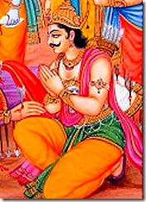
Texts 44-52: Krsna Accepts Kuntidevi’s Prayers and Hears the distressed Words of Yudhisthira Maharaja
Krsna smiles and accepts Kuntidevi’s glorification and statement of dependence
No one could make Lord Kṛṣṇa stay at Hastināpura
when He decided to start for Dvārakā, but the simple
request of King Yudhiṣṭhira that the Lord remain there
for a few days more was immediately effective. This
signifies that the power of King Yudhiṣṭhira was loving
affection, which the Lord could not deny.
Yudhisthira expresses his anxiety over the war and the death of all his relatives simply to enthrone him.
The auspiciousness of His kingdom had increased because of 3 ashvamedha yagnas but he still had to live with the fact that millions had died to place him on the throne.

Slide 16
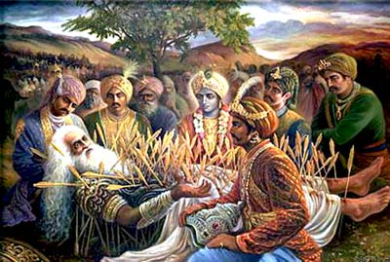
Texts 44-52: Krsna Accepts Kuntidevi’s Prayers and Hears the distressed Words of Yudhisthira Maharaja
Vyasadeva and other sages knew Yudhishthira could not be pacified because they were aware that Krsna had a plan.
Krsna wanted Yudhisthira Maharaj to question Bhishmadeva who was now close to death.

Slide 17
References
Unveiling His Lotus Feet – By HG Bhurijana Prabhu
Lectures by HG Bhurijana Prabhu(iskcondesiretree.info –Srimad Bhagavatam Overview)

